Slide 1
Developer Training
Modular Templates Lab

Slide 2
Overview
Motivation
  Create templates that are less rigid in their structure
  Reuse sections/components
What about drag-and-drop?
  DnD is only available for Component Library-based projects

Slide 3
Objectives
Part 1 – Section Builder
  Overview of the section builder pattern
  Create basic sections/components
  Create section builder component
Part 2 – FormSelector Control
  Overview of the FormSelector control
  Create template using FormSelector

Slide 4
Part 1
Section Builder

Slide 5
Overview
Three building blocks
  Input form component
    DropDownContainer
    ShowFormSelector
  Sections/Components
  (doesn’t have to be Component Library but it is easier if you do)
  List panel

Slide 6
DropDownContainer
Renders a dropdown selector
User selection in the dropdown will show the controls associated with the choice
❱ ❱ ❱ ❱ ❱ WARNING ❰ ❰ ❰ ❰ ❰
DropDownContainer renders
ALL the input controls for ALL components.
This can lead to performance problems on assets with many components and/or a long list of sections.

Slide 7
DropDownContainer
var sectionChoices = new Dictionary<string, string>() {
{"Carousel", "carousel"},
{"Jumbotron", "jumbotron"},
{"6 Icon Stats Grid", "icon_stats_grid"}
};
Input.StartDropDownContainer("Section", "section", sectionChoices, firstRowLabel: "--- Select section ---");
new Carousel().ComponentInput(asset, context, "carousel");
Input.NextDropDownContainer();
new Jumbotron().ComponentInput(asset, context, "jumbotron");
Input.NextDropDownContainer();
new IconStatsGrid().ComponentInput(asset, context, "icon_stats_grid");
Input.EndDropDownContainer();

Slide 8
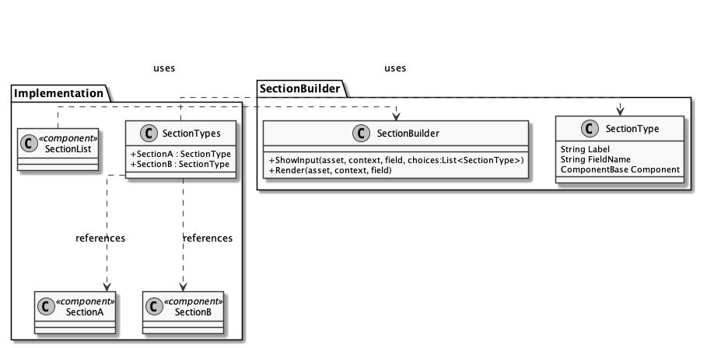
Section Builder Pattern

Slide 9
LAB
Getting set up

Slide 10
Setup - Components
1 | Locate the training sandbox folder
2 | Create a new site root with you name. Ensure that you include Component Library | File > New > Site Root {name}
 | Locate the component definitions folder | {siteroot}/Component Project/Component Project/Component Definitions
3 | Create the following components using the markup in the clipboard Jumbotron Richtext Signpost Three Signposts

Slide 11
Setup – Nav Wrapper
1 | Locate the templates folder | {siteroot}/Component Project/Component Project/Templates
2 | Create a new template | File > New > Model: Template Custom Nav Wrapper
3 | Open the output handler and copy in the sample markup from the clipboard.

Slide 12
Fixed Structure Template
1 | Locate the template definitions folder | {siteroot}/Component Project/Component Project/Template Definitions
2 | Create a new template definition called “Fixed Structure” and add one or more of the components to it. | File > New > Model : Template Fixed Structure
3 | Locate the content folder | {siteroot}
4 | Create a new templated asset using the template | File > New > File Fixed Structure Demo

Slide 13
LAB
DropDownContainer

Slide 14
Create T1 Section Component
1 | Locate the Component Definitions folder. | {siteroot}/Component Project/Component Library/Component Definitions
2 | Create a new Component Folder. | T1 Components
3 | In the new folder, create a new component. | T1 Section
4 | Open the new component definition and go to the ‘Advanced’ tab. Set the following properties. | [x] Hide from Content Block Panel [x] Read Only Component
5 | Click Save.
6 | Once you have the notification that the save has been completed, click the link to the generated class. | Components_T1Section.cs

Slide 15
Create T1 Section Component
7 | Edit the ComponentInput method to create a drop-down container with a choice of our three components.
8 | Edit the ComponentOutput method to render the chosen component.
9 | Click Save.
10 | Go back to the T1 Section component definition and click “Force Reload”.
11 | Go to the “Preview Content” tab and ensure that the controls are being rendered.

Slide 16
Create T1 Section List Component
1 | Locate the T1 Components folder. | {siteroot}/Component Project/Component Library/Component Definitions/T1 Components
2 | Create a new component. | T1 Section List
3 | Open the new component definition and set the pattern to be a list of T1 sections | <cp-list name=“sections”> {item:T1Section} </cp-list>
4 | Click Save.

Slide 17
Create T1 Template Definition
1 | Locate the Template Definitions folder. | {siteroot}/Component Project/Component Library/Template Definitions
2 | Create a new template. | T1 Template
3 | Open the new definition and on the “Components” tab, set up a section using the T1 Section List component.
4 | On the ”Wrapper” tab, pick the Nav Wrapper definition.
5 | On the “Settings” tab, ensure Create is selected.
6 | Click Save.

Slide 18
Create T1 Content
1 | Locate the site root. | {siteroot}
2 | Create a new templated asset, using File > New > File, with the following properties | Name = Page One Template = T1 Template Workflow = Basic Workflow
3 | Open the newly created asset in form edit mode.
4 | Add one or more sections to the new asset, save it and then preview.

Slide 19
LAB
SectionBuilder

Slide 20
Create class SectionType
1 | Locate the Library folder. | {siteroot}/Component Project/Library
2 | Create a new class, using File > New > Custom C# Class | SectionType
3 | Open the newly created class and create the class.

Slide 21
Create class SectionBuilder
1 | Locate the Library folder. | {siteroot}/Component Project/Library
2 | Create a new class, using File > New > Custom C# Class | SectionBuilder
3 | Open the newly created class and create the class.

Slide 22
Refactor T1 Component
1 | Locate the T1 Components folder. | {siteroot}/Component Project/Component Library/Component Definitions/T1 Components
2 | Edit the existing T1 Section component definition.
3 | Go to the “Advanced” tab and click on the link to the generated class file. | Components_T1Section.cs
4 | Change the component methods to use the corresponding SectionBuilder methods.
5 | Click Save.

Slide 23
Part 2
FormSelector control

Slide 24
Overview
FormSelector is a new form control designed to replace DropdownContainer
Use it for assets that have large amounts of form data.
Created to reduce the initial rendering time of an asset by reducing the number of form controls that need to be processed.
Three building blocks
  FormSelector
  Sections/Components
  (doesn’t have to be Component Library but it is easier if you do)
  List panel

Slide 25
Template API Method
Input.ShowFormSelector(string label, string fieldName, Dictionary<string, string> forms, string defaultValue, string firstRowLabel)
string label | The label to display for the FormSelector
string fieldName | The name of the FormSelector field. This must be a unique within the template
Dictionary<string, InputFormParams> forms | A list of key/value pairs containing the label and a structure with the field value and input handler for each section configured for the template
string defaultValue (Optional) | The value (form input template name) of the form that a new asset should load by default
string firstRowLabel (Optional) | Inserts an empty form option at the top of the forms list

Slide 26
Form Input Templates rules
The word "input" needs to be in the handler name
  The rest of the name can be anything but it must be unique to the template.
Field names in the form input templates need to be unique within the entire input form
    Replicates the the way DropdownContainers works
    Preserves field values for existing forms

Slide 27
Cautions
Cannot use this type of control with Component Library Component Definitions
  Would need to add input_* handlers to the Component Definition template
Cannot use this type of control with Component Library Template Definitions
  CL does not generate the required input_* handlers
Each section list’s field name must be unique as there is no CL field name composition
If using the Section Builder pattern:
  Every section needs a corresponding input handler
  Every template that uses the “section list” will require a copy of the input handler

Slide 28
LAB
SectionBuilder Implementation v2

Slide 29
Create class SectionTypes
1 | Locate the Library folder. | {siteroot}/Component Project/Library
2 | Create a new class, using File > New > Custom C# Class | SectionTypes
3 | Open the newly created class and create the entries to ‘register’ the following components as section types: Jumbotron Richtext Signpost Three Signposts

Slide 30
Create input form handlers
1 | Locate the Templates folder. | {siteroot}/Component Project/Templates
2 | Create a new template. | FormSelectors
4 | Create a new input handler and add the component input code to it. | input_announcement.aspx
5 | Create a new input handler and add the component input code to it. | input_three_signposts.aspx
6 | Create a new input handler and add the component input code to it. | input_rich_text.aspx

Slide 31
Create T1 Section Component
1 | Locate the Component Definitions folder. | {siteroot}/Component Project/Component Library/Component Definitions
2 | Create a new Component Folder. | T1 Components
3 | In the new folder, create a new component. | T1 Section
4 | Open the new component definition and go to the ‘Advanced’ tab. Set the following properties. | [x] Hide from Content Block Panel [x] Read Only Component
5 | Click Save.
6 | Once you have the notification that the save has been completed, click the link to the generated class. | Components_T1Section.cs

Slide 32
Create T1 Template
1 | Locate the Template Definitions folder. | {siteroot}/Component Project/Component Library/Template Definitions
2 | Create a new template definition. | File > New > Model: Template T1 Template
3 | Create a new ‘section’ that uses the ’no rail’ layout and the T1 Section component
4 | Select a navigation wrapper
5 | Ensure the “Create” checkbox is ticked and click Save.

Slide 33
Create T1 Content
1 | Locate the content folder | {siteroot}
2 | Create a new templated asset. | File > New > File Name: {content-name} Template: T1 Template Workflow: Basic Workflow
3 | Open the new asset in form edit mode.

Slide 34
Thank You!

